Slide 1



TI FTRC
Advanced Algorithms for THz Sensing and Recognition
Murat Torlak and Yiorgos Makris
University of Texas at Dallas
Nov. 15, 2019 Review

Slide 2
Advanced Algorithms for THz Sensing and Recognition
Description: Understand the limitations and challenges in THz FPA/IR imaging technology; identify solutions for target applications such as 3D gesture recognition, movement and presence detection.
Goals: Develop advanced real-time multi-antenna signal processing techniques for THz FPA/IR sensors to reconstruct and recognize targets in complex environments.
Principal Investigators: Murat Torlak (University of Texas at Dallas)
Yiorgos Makris (University of Texas at Dallas)
Students Current Status
Josiah W. Smith (MT) PhD (Fall’19)
Shiva Shankar Thiagarajan (YM) PhD (Sp’18)
Bhaskar Raj Upadhyay (MT) PhD (Fall’18)
Richard Willis, (YM) Intern
TI Liaisons:
Aleksandar Purkovic, Arthur Redfern, Anand Dabak, Dan Wang

Slide 3
Plans and Deliverables (Years 2/3)
Milestones
Developed a MATLAB based GUI to streamline raw mmWave radar and IR sensor data collection (2018)
Performed the initial testing of machine learning methods with real mmW data sets (2018)
Two PhD students (Bhaskar/Josiah) to work on working on gesture recognition with 77GHz radar and single pixel THz radar (~300 GHz) (2019)
Deliverables
Report on the HGR DSP and ML methods (Nov. 15, 2019)

Slide 4
Revised Schedule after TI Feedback
Year | 1 | 2 | 3 | 4 | 5
Milestones | Develop a detailed mathematical model for THz FPA with reflectors and THz transceivers. Develop a geometric reference model including Doppler shift patterns for 3D gesture recognition and motion detection Software implementation of machine learning algorithms for THz sensing/imaging. | Complete 24/77 GHz hardware demonstrator with existing chipsets to achieve millimeter-scale accuracy in 3D gesture recognition and motion recognition. Develop multi antenna signal processing to reduce speckles and to correct reflector aberration and machine learning techniques. | Software implementation of real-time multi antenna signal processing techniques and machine learning algorithms for THz-FPA on a custom CPU+GPU. Refine the mathematical models of THz-FPA and geometric models based on 77 GHz demonstrator results. | Verify and fine tune low complexity algorithms with THz FPA on silicon with TI and center collaborators. Software implementation of machine learning algorithms on a custom CPU+GPU for THz sensors. Finalize the algorithms to eliminate errors due to multipath. | (If all the milestones are met and authorized by TI) Build and characterize optimized resolution limits of THz FPA with THz chipsets incorporating reflectors and machine learning on CPU/GPU/FPGA for 3D gesture and motion recognition. Characterize the performance limits of aberration mitigation algorithms.
Deliverables | Report on the mathematical model of THz FPA with reflectors and THz radios Report on geometric models for 3D gesture recognition and the machine learning algorithms for THz sensing/imaging | Report on measurement results using 24/77 GHz demonstrator. Software implementation of multi antenna signal processing and machine learning for THz-FPA gesture and motion detection | Report on software implementation and refined mathematical models of the end-to-end sensing and imaging system with machine learning algorithms. Report on the algorithms to increase field of view. | Report on measurement results on the performance limits of multiantenna signal processing algorithms and machine learning techniques used in THz-FPA sensors. | Report on measurement results of fully functional THz-FPA imager enabled by real-time multiantenna signal processing algorithms and machine learning. CPU/GPU/FPGA software.

Slide 5
TI Feedback (Apr’19)
Good reaction to feedback from previous reviews with good momentum.
Response: Monthly conference calls. Good presence from TI engineers.
Need calibration on coming together of all thrusts – systems, circuits and packaging at the end of 4/5 years.
Next review to also focus on project dependencies to hit ultimate system-level goal
Response: Our students in systems/circuits thrusts have now greater interactions. They have been working towards setting up common hardware setups for both THz and IR imaging efforts.
The effort to collect all of the raw data is impressive and needed to really understand the capabilities of ML algorithms;
Very limited gesture conditions that may not scale to more natural interactions.
Response: We are open to adopting our methods for a practical application (sign language, human-computer interface, etc)

Slide 6
TI Feedback (Apr’19)
The hand/body interaction was an interesting observation (shadowing),
Do the slight perturbations to the test conditions (rotation of the hand, other objects nearby, etc.) fundamentally limit the application example?
Response: Our dataset already covers many of these conditions.
The achieved accuracies after enough training are high
Is this over-fit to the dataset such that small changes reset the accuracy to 50%?
Does continuing to pursue improvements in static gesture performance from a low dimensionality radar make sense?
Response: Our efforts now include dynamic gesture recognition. More details will be given in the presentation.

Slide 7
Front-End Signal Processing and Data Collection Setup
Josiah W. Smith and Murat Torlak

Slide 8
Outline
Definition of Terms
Static Hand Gesture Recognition
Setup and Data Collection
Preprocessing
Dynamic Hand Gesture Recognition
Transition Gestures
Setup and Data Collection
Preprocessing
New Terahertz Imager
Motion detection via phase extraction
Mechanical Scanning Imager

Slide 9
Definition of Terms
FOV: Field of View
MIMO: Multiple Input Multiple Output
FFT: Fast Fourier Transform
TDM: Time Division Multiplexing
PRI: Pulse Repetition Interval
Notes:
They requested a page with some term definitions. I’m not entirely sure if this is necessary, but perhaps it is helpful

Slide 10
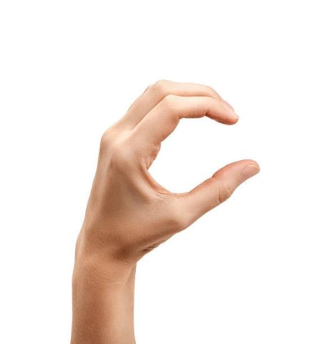

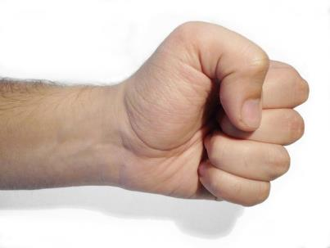

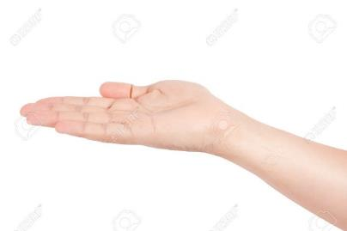

Static Hand Gestures
Fist
C
Palm
Perpendicular (perp)
Thumbs Up (tu)
Two

Slide 11
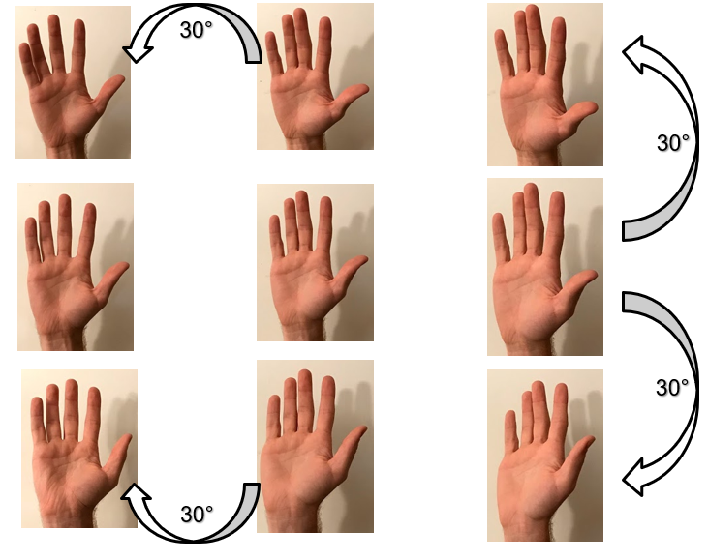
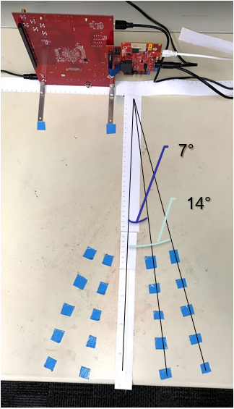
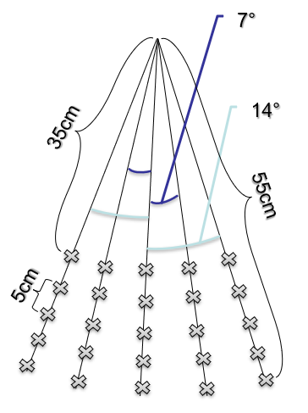
Setup and Degrees of Freedom
As shown below, capture FOV ranges from 35-55cm
across a FOV of
28°, at increments
of 5cm.

Slide 12
Static Datasets
Dataset 1: 2000/class
Same location at radar bore side
Single subject, across several weeks
83% Accuracy
Dataset 2: 4000/class
Ranges 35cm-55cm and 28° FOV
3 subjects, hand too close to torso
61% Accuracy
Dataset 3: 405/class
Ranges 45cm-55cm and 14° FOV
Hand held away from torso
86% Accuracy

Slide 13
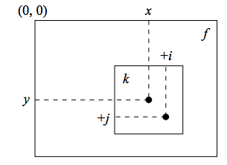
Preprocessing
Data formatting
Layer real and imaginary parts
Leverage correlation between channels by maintaining matrix format rather than vectorizing data
Drastic accuracy increase
Null Torso Peak
Attempt to remove torso peak and sidelobes
Some accuracy reduction, revisit
Range-Channel Autocorrelation
2D correlate to create spatial invariance
No change in accuracies, revisit

Slide 14
Preprocessing Results
Angle FFT
Reformat data with prior knowledge of virtual array structure
Exploit both elevation and azimuth information
Accuracies increase notably
Useful moving forward
 | Dataset 1 | Dataset 2 | Dataset 3
Raw | 83% | - | -
Reformatted | 95% | 61% | 86%
Nulled | - | 61% | 80%
Autocorr | 95% | 62% | 87%
Angle FFT | 99% | 75% | 91%

Slide 15
Dynamic Hand Gesture Recognition

Slide 16
Dynamic Transition Gestures
Fist
C
Fist
Palm
Fist
Perpendicular (perp)
Fist
Two
Gesture 30-50cm from radar
Torso kept away from gesture
Captures all taken consecutively
50 captures/gesture
Fist
Thumbs Up (tu)

Slide 17
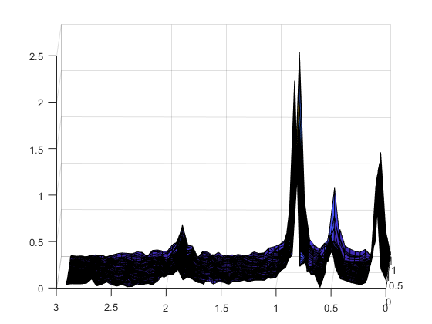
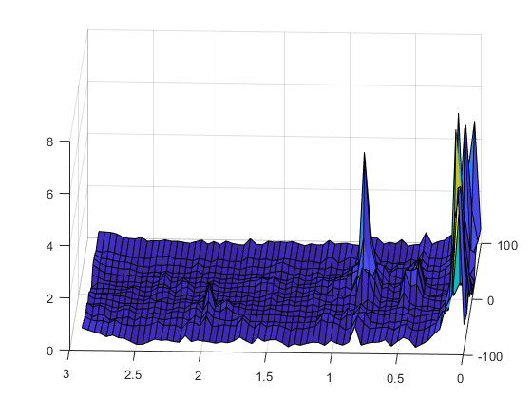
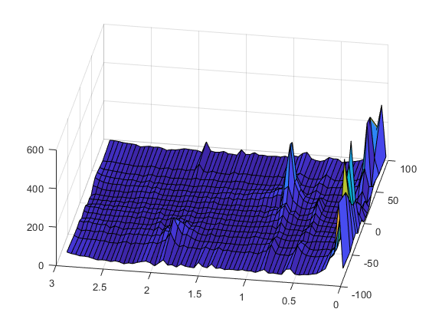
Dynamic Transition Results
2 Datasets
Fast (5ms PRI)
Slow (15ms PRI)
Preprocessing
Range Angle
Range Doppler
Range, Angle, and Doppler
 | Slow Dataset | Fast Dataset
Range | 58% | 74%
Range Angle | 66% | 74%
Range Doppler | 72% | 78%
RAD | 72% | 86%
Fist-Tu Range vs Time
Fist-Tu Range vs Angle
Fist-C Angle vs Velocity
Conclusion: Need to leverage doppler information better

Slide 18
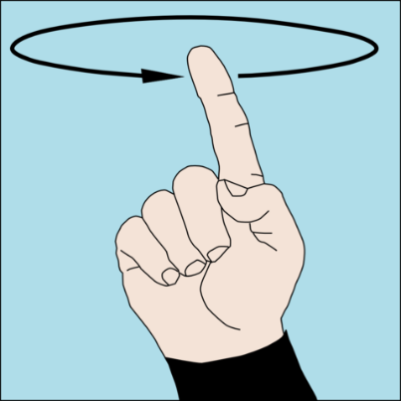
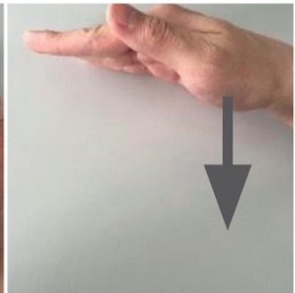
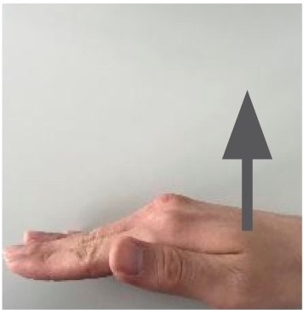
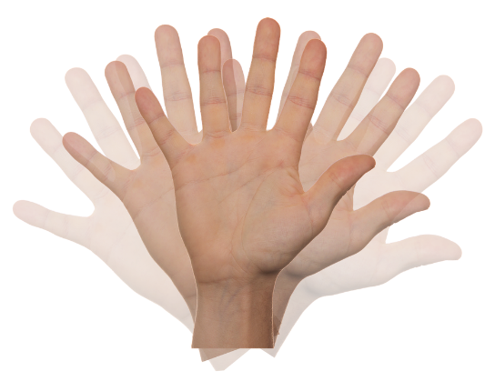
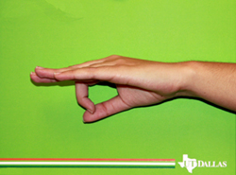
Dynamic Hand Gestures
Circle
Push
Pull
Wave
Whoosh

Slide 19
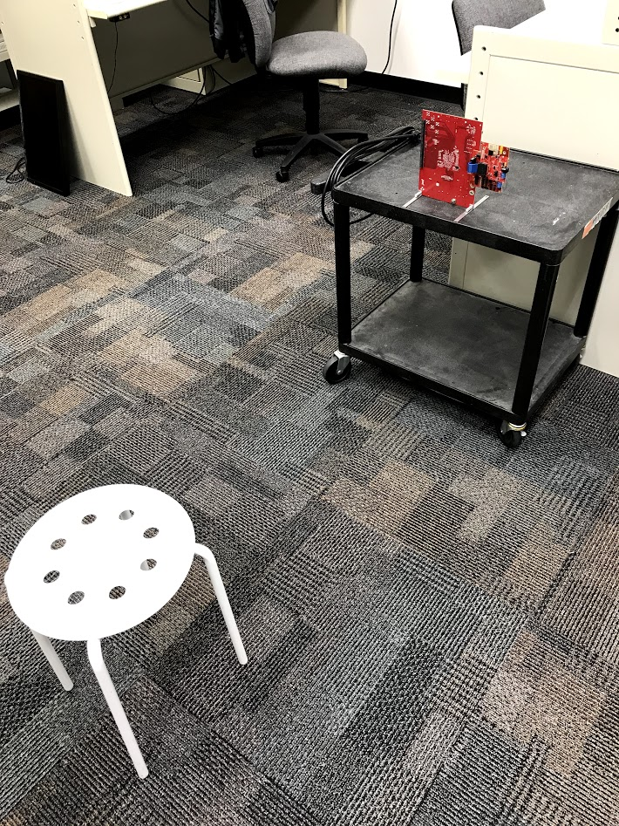
Data Collection Setup
Chest high radar
~1m from sitting user
Simple range FFT computed for each capture
Radar Parameters:
3 TX, 4 RX (12 Virtual MIMO Channels)
16bit, Complex1x
Start Frequency: 77GHz
Bandwidth: 3.99948GHz
R_{max} = 3m
Slope: 99.987 Hz/s
Sample Rate: 2000 ksps
64 Fast Time Samples

Slide 20
Dynamic Dataset and Size
Dataset 5 – 600/class
512 frames over 2.56s (5ms PRI)
Captured across different days, same subject
97.8% classification accuracy
Size of data for each class (64,12,512,600)
64: range bins
12: virtual antennas
512: slow-time (frame capture)
600: captures/class

Slide 21
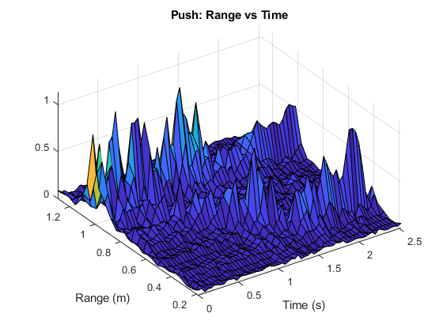
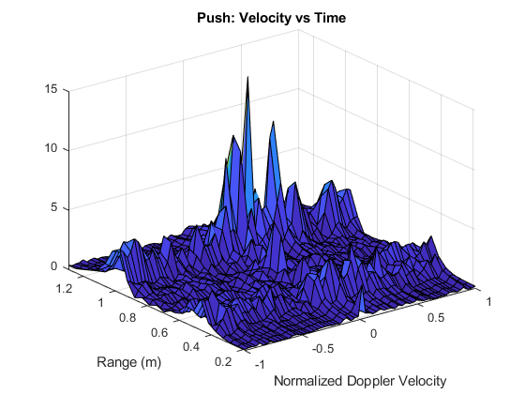
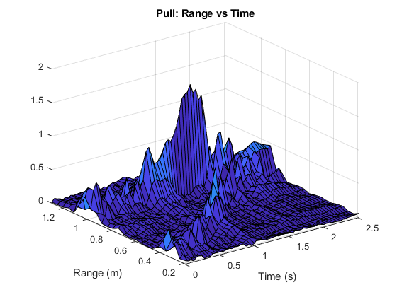
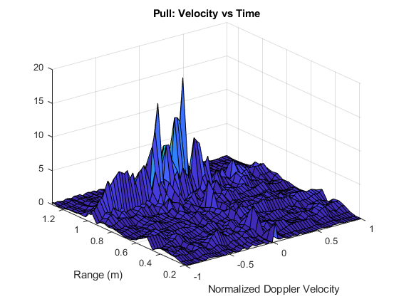
Slow Time to Velocity Domain

Slide 22
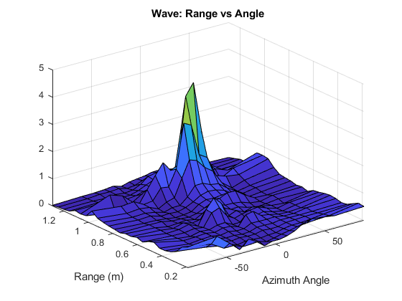
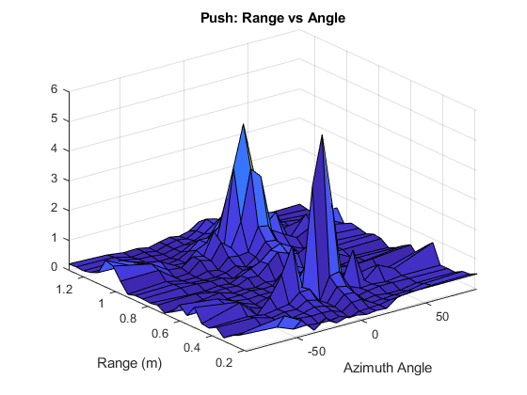
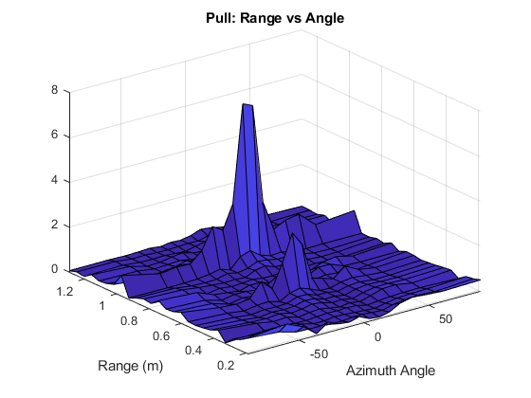
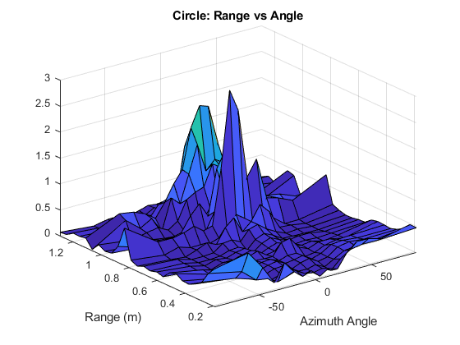
Channel to Azimuth Angle Domain
Considering geometry of aperture, FFT across channel domain produces angular domain
16 Angle Bins
Filter angular domain to effectively achieve RX beamforming

Slide 23
Preprocessing Results
Subsampling
Take 5ms data and subsample to 40ms
Results Similar
STFT Across Slow Time Domain
Analog problem to asynchronous speech classification
Increase in dimensionality: computational complexity
 | Dataset 5 | 40ms PRI | 40ms PRI with Filter
Range | 97.8% | 98.7% | 98.7%
Range Angle | 99.3% | 99% | 99%
Range Doppler | 99.2% | 99% | 99%
Range, Angle, Doppler | 99.7% | 99.3% | 99.2%
Doppler STFT | 99.8% | 99.6% | 99.3%
Notes:
LD: Large Datseta

Slide 24
Interfacing with Terahertz Sensor IC

Slide 25

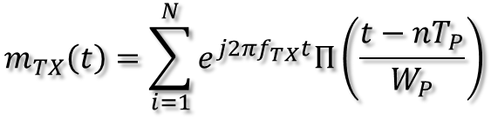
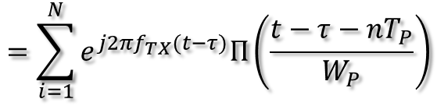
Motion Detection via Phase Extraction
50kHz
USRP
Software
273.6GHz
480MHz
250kHz
RF-TX
RF-RX
IF
D-IF
MD-IF
LPF
100kHz
479.75GHz
200kHz
Signal Generator
Signal Generator
Phase
Phase Extractor
Signal generators modulate carrier with pulse train
$$m_{TX}\left(t\right)=\sum_{i=1}^{N}{e^{j2πf_{TX}t}Π\left(\frac{t−nT_{P}}{W_{P}}\right)}$$
$$m_{RX}\left(t\right)=m_{TX}(t−τ)$$
$$=\sum_{i=1}^{N}{e^{j2πf_{TX}(t−τ)}Π\left(\frac{t−τ−nT_{P}}{W_{P}}\right)}$$

Slide 26
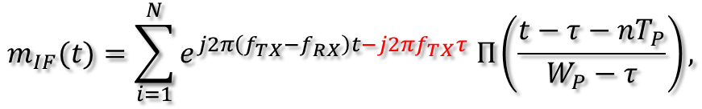
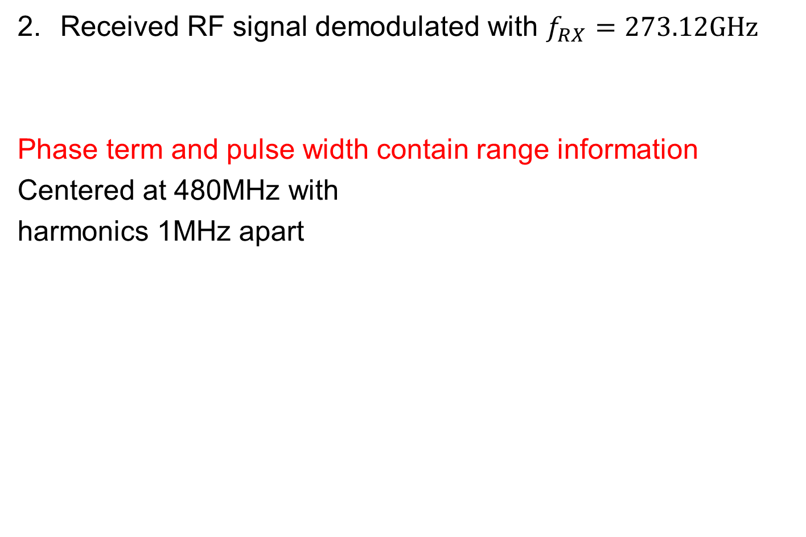

Motion Detection via Phase Extraction
Received RF signal demodulated with $f_{RX}=273.12GHz$
Phase term and pulse width contain range information
Centered at 480MHz with
harmonics 1MHz apart
$$m_{IF}(t)=\sum_{i=1}^{N}{e^{j2π\left(f_{TX}−f_{RX}\right)t−j2πf_{TX}τ} Π\left(\frac{t−τ−nT_{P}}{W_{P}−τ}\right),}$$
$$τ=\frac{R}{c}$$

Slide 27
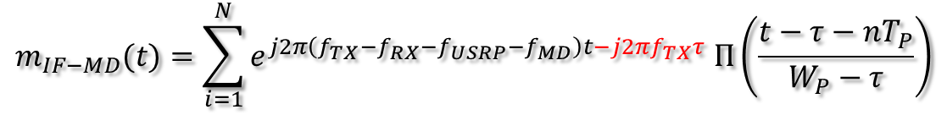
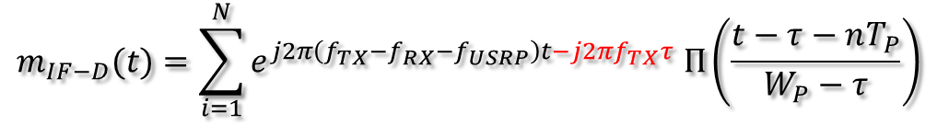


Motion Detection via Phase Extraction
USRP I-Q Demodulation: D-IF
Software Demodulation in MATLAB: MD-IF
Phase Extraction and Range Estimation
Single Peak at
50kHz
$$m_{IF−D}(t)=\sum_{i=1}^{N}{e^{j2π\left(f_{TX}−f_{RX}−f_{USRP}\right)t−j2πf_{TX}τ} Π\left(\frac{t−τ−nT_{P}}{W_{P}−τ}\right)}$$
$$m_{IF−MD}(t)=\sum_{i=1}^{N}{e^{j2π\left(f_{TX}−f_{RX}−f_{USRP}−f_{MD}\right)t−j2πf_{TX}τ} Π\left(\frac{t−τ−nT_{P}}{W_{P}−τ}\right)}$$
$$φ=−2πf_{TX}τ$$
$$\hat{R}=−\frac{φ}{2πf_{TX}}c$$

Slide 28
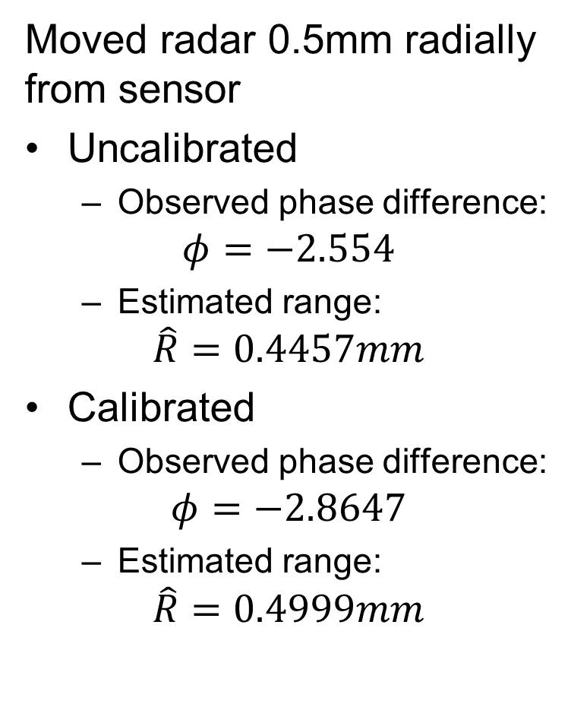
Relative Range Estimation
Moved radar 0.5mm radially from sensor
Uncalibrated
Observed phase difference:
$$φ=−2.554$$
Estimated range:
$$\hat{R}=0.4457mm$$
Calibrated
Observed phase difference:
$$φ=−2.8647$$
Estimated range:
$$\hat{R}=0.4999mm$$

Slide 29
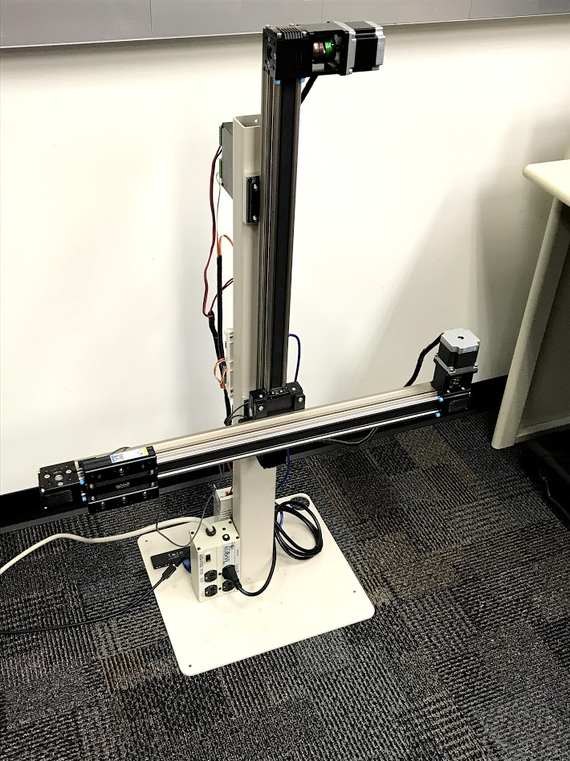
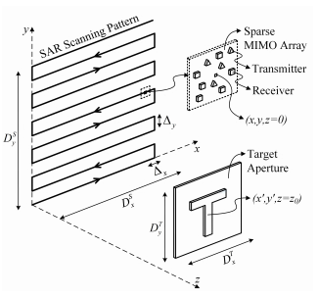
Mechanical Scanning Imager
2D linear mechanical scanning allows for high resolution synthetic aperture imaging

Slide 30
Conclusions and Ongoing Work
Expanded experimental data collection to dynamic gestures using TI mmWave radars
Proposed and tested angular domain processing
RCS variation is significant when hand position is varied
Investigate ways to enhance RCS from hand when shadowed by the person’s body.
Study the impact of each variation in the hand position
Baseband hardware and signal processing are being interfaced with 0.3-THz CMOS-based single pixel
Develop the calibration strategies, baseband signal processing and understand its limits

Slide 31
Conclusion
Developing synergy between data collection, preprocessing, and machine learning
Expanded experimental data collection to dynamic gestures using TI mmWave radars
Careful consideration of data format/structure enables highly accurate classification models
Preprocessing techniques (i.e., angular FFT) significantly enhance data prior to classification
Baseband hardware and signal processing are being interfaced with 0.3-THz sensor IC
Large, varied dynamic gesture dataset
Asynchronous dynamic gesture input case
Develop the calibration strategies, baseband signal processing for THz sensor and understand its limits
Future Work

Slide 32
References
[1] H. Kaur and J. Rani, "A review: Study of various techniques of Hand gesture recognition," 2016 IEEE Int. Conf. on Power Electronics, Intelligent Control and Energy Systems, Delhi, 2016, pp. 1-5.
[2] M. K. Ahuja and A. Singh, "Static Vision Based Hand Gesture Recognition Using Principal Component Analysis, " pp. 402-406, 2015.
[3] D. Q. J. Dqg, V. lurp, L. Pdun, O. Kdqg, H. W. Lv, K. Kinect, H. G. Recognition, Z. Fdq, E. H. Fodvvlilhg, E. S. Fodvvlilhuv, and V. Dv, "using Kinect Depth Camera, " pp. 5-8,2015.
[4] J. S. Sonkusare, N. B. Chopade, R. Sor, and S. L. Tade, "A Review on Hand Gesture Recognition System, " 2015 Int. Conf Comput. Commun. Control Autorn., pp. 790-794, 2015.
[5] L. Chen, F. Wang, H. Deng, and K. Ji, "A survey on hand gesture recognition, " 2013 Int. Conf. Comput. Sci. Appl. CSA 2013, pp. 313-316,2013.
[6] S. Atsushi, "Hand Gesture based TV Control System, " Korea -Japan Jt. Work. Front. Comput. Vis., pp. 121-126,2013.
[7] S. Muttena, R. Shiva, S. Sriram, and S. Murugavalli, "Simulation of Speech by Identifying and Classifying Dynamic Gestures, " no. May, pp. 192-197,2015.
[8] J. Chastine, N. Kosoris, and J. Skelton, "A study of gesture-based first person control, " Proc. CGAMES - Int. Conf Comput. Games AI, Animat. Mobile, Interact. Multimedia, Educ. Serious Games, pp. 79-86,2013.
[9] S. S. Rautaray and A. Agrawal, "Vision based hand gesture recognition for human computer interaction: a survey, " Artif. IntelI. Rev., vol. 43, no. 1,2012.
[10] Z. Ren, J. Meng, and J. Yuan, "Depth Camera Based Hand Gesture Recognition and its Applications in Human-Computer-Interaction, " Proc. IEEE Int. Conf Inf Commun. Signal Process., no. I, pp. 3-7, 2011.
[11] J. L. Raheja, M. Minhas, D. Prashanth, T. Shah, and A. Chaudhary, "Robust gesture recognition using Kinect: A comparison between DTW and HMM, " Optik (Stuttg)., vol. 126, no. 11-12, pp. 1098- 1104,2015.
12] L. Xuan and Z. Hong, "An improved canny edge detection algorithm," 2017 8th IEEE International Conference on Software Engineering and Service Science (ICSESS), Beijing, 2017, pp. 275-278.
[13] Z. Zhang, Z. Tian and M. Zhou, "Latern: Dynamic Continuous Hand Gesture Recognition Using FMCW Radar Sensor," in IEEE Sensors Journal, vol. 18, no. 8, pp. 3278-3289, April15, 15 2018.
[14] M. E. Yanik and M. Torlak, “Near-Field MIMO-SAR Millimeter-Wave Imaging With Sparsely Sampled Aperture Data,” IEEE Access, vol. 7, pp. 31801–31819, 2019.

Slide 33
Data Processing and Machine Learning for Gesture Recognition
Yiorgos Makris
University of Texas at Dallas
Nov. 15, 2019

Slide 34
Plans and Deliverables (Years 2/3)
Milestones
Developed a MATLAB based GUI to streamline raw mmWave radar and IR sensor data collection (2018)
Performed the initial testing of machine learning methods with real mmW data sets (2018)
Recruited two PhD student s(Bhaskar/Josiah) to work on various signaling schemes (comparing chirps/FSK) & methods to combine 77GHz radar and 410 GHz imager (2018)
Develop a detailed mathematical model for THz FPA with reflectors and THz transceivers (delayed to the 2nd /3nd year)
Software implementation of machine learning algorithms for THz sensing/imaging (delayed to the 2nd/3nd year)
Deliverables
2nd year deliverables are swapped with 1st year deliverables
HGR MATLAB app with Python ML engine (Oct. 15, 2019)
IR HGR prototype (Nov. 15, 2019)
Report on the HGR DSP and ML methods (Nov. 15, 2019)

Slide 35
Plans and Deliverables (Year 3)
Milestones
Improve a MATLAB HGR app with space-frequency-Doppler signal processing (Nov’19)
Extend machine learning/Deep learning methods with new mmW/IR data sets
Software implementation of machine learning algorithms for THz sensing/imaging
Develop a detailed mathematical model for THz FPA with reflectors and THz transceivers (3rd year)
Deliverables
Report on the results of new applications using mmW demonstrator and multi antenna signal processing and machine learning for hand gesture recognition.
Software implementation of multi antenna signal processing and machine learning for hand gesture recognition.

Slide 36
Advanced Algorithms for THz Sensing and Recognition: Current Schedule
Year | 1 | 2 | 3 | 4 | 5
Milestones | Develop a detailed mathematical model for THz FPA with reflectors and THz transceivers. Develop a geometric reference model including Doppler shift patterns for 3D gesture recognition and motion detection Software implementation of machine learning algorithms for THz sensing/imaging. | Complete 24/77 GHz hardware demonstrator with existing chipsets to achieve millimeter-scale accuracy in 3D gesture recognition and motion recognition. Develop multi antenna signal processing to reduce speckles and to correct reflector aberration and machine learning techniques. | Software implementation of real-time multi antenna signal processing techniques and machine learning algorithms for THz-FPA on a custom CPU+GPU. Refine the mathematical models of THz-FPA and geometric models based on 77 GHz demonstrator results. | Verify and fine tune low complexity algorithms with THz FPA on silicon with TI and center collaborators. Software implementation of machine learning algorithms on a custom CPU+GPU for THz sensors. Finalize the algorithms to eliminate errors due to multipath. | (If all the milestones are met and authorized by TI) Build and characterize optimized resolution limits of THz FPA with THz chipsets incorporating reflectors and machine learning on CPU/GPU/FPGA for 3D gesture and motion recognition. Characterize the performance limits of aberration mitigation algorithms.
Deliverables | Report on the mathematical model of THz FPA with reflectors and THz radios Report on geometric models for 3D gesture recognition and the machine learning algorithms for THz sensing/imaging | Report on measurement results using 24/77 GHz demonstrator. Software implementation of multi antenna signal processing and machine learning for THz-FPA gesture and motion detection | Report on software implementation and refined mathematical models of the end-to-end sensing and imaging system with machine learning algorithms. Report on the algorithms to increase field of view. | Report on measurement results on the performance limits of multiantenna signal processing algorithms and machine learning techniques used in THz-FPA sensors. | Report on measurement results of fully functional THz-FPA imager enabled by real-time multiantenna signal processing algorithms and machine learning. CPU/GPU/FPGA software.

Slide 37

Questions ??

Slide 38
Backup Slides

Slide 39
Data Format
At each location, one capture is made per hand orientation
Each capture consists of 64 frames, only the first fame is used
100 captures = 4 different hand orientations at each of the 25 locations
Radar Parameters:
3 TX, 4 RX (12 Virtual MIMO Channels)
16bit, Complex1x
Start Frequency: 77GHz
Bandwidth: 3.99948GHz
R_{max} = 3m
Slope: 99.987 Hz/s
Sample Rate: 2000 ksps

Slide 40
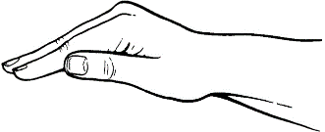
Dynamic Hand Gesture Recognition
Consider two dynamic hand gestures, pushing (down) and pulling (up)
We expect the pushing (down) motion to result in a positive velocity as it is coming towards the radar.
Similarly, we expect the pulling (up) motion to result in a negative velocity.
Pulling
Pushing
RADAR

Slide 41
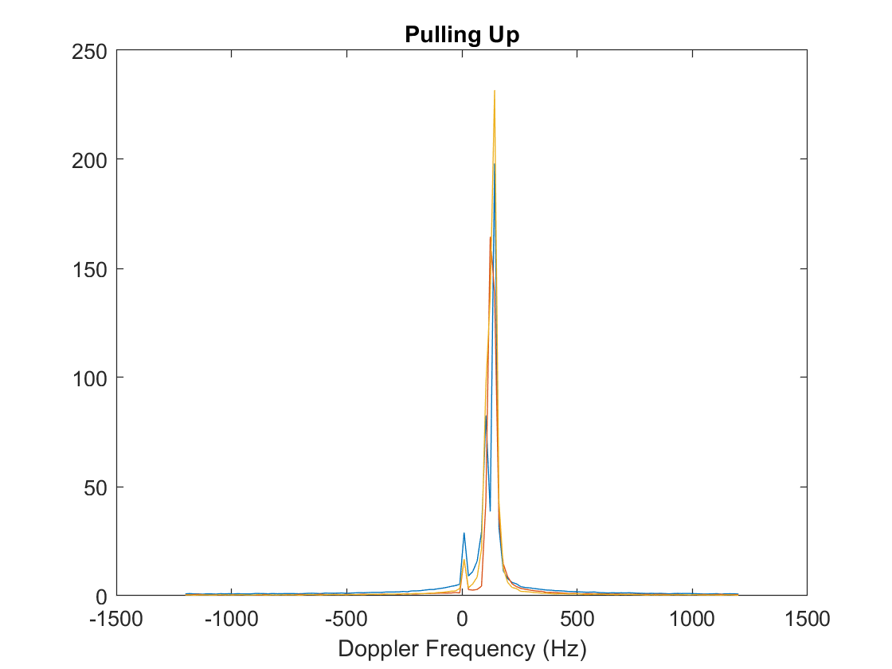
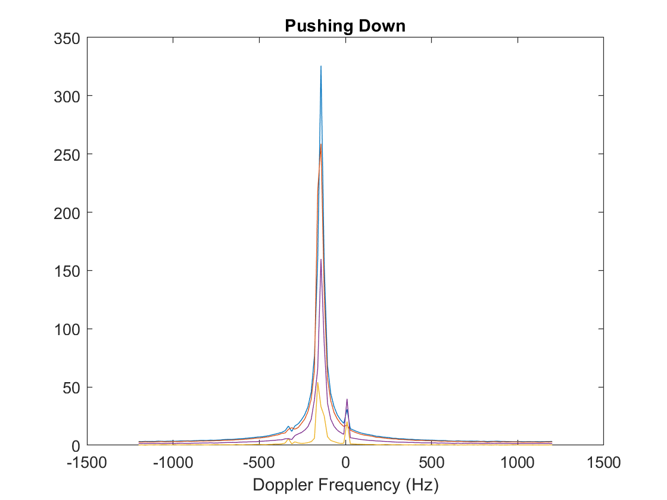
Doppler Processing
Pulling up vs pushing down

Slide 42
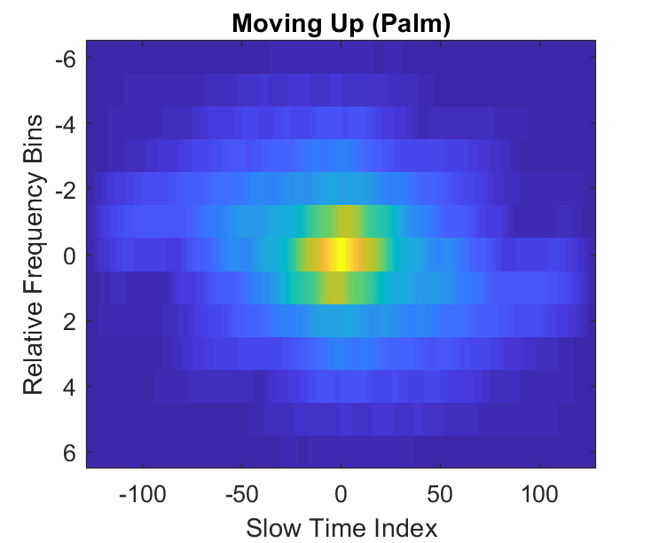
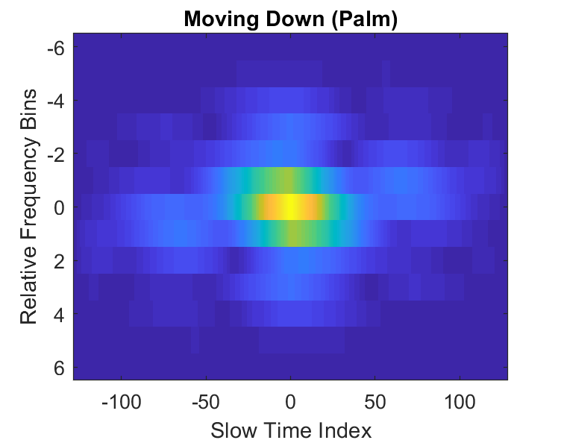
Dynamic Hand Gesture Example
Range Frequency-Slow Time Analysis

Slide 43
Old Dataset Shaping
Frequency Bin 1
Frequency Bin 10
S1
S2
S3
S4
S1
S2
S3
S4
Gesture Category
Instance 1
Palm
Instance 2
Instance 3
Fist
12000 instances
10 range bins*4 sensors = 40 features
Instance
6 X 2000
Two

Slide 44
New Dataset Shaping
Frequency Bin 1
Frequency Bin 54
S1
S2
S3
S4
S1
S2
S3
S12
Gesture Category
Instance 1
Palm
Instance 2
Instance 3
Fist
24000 instances
54 range bins*12 sensors = 648 features
Instance
6 X 4000
Two

Slide 45
Fully Connected Network
Fully connected neural network investigating the effects of deeper architectures (2-4 layers), batch sizes and dropout layers.
1x80
1x80
1x80
1x6
Input
F.C
F.C
Dropout
Softmax
Definition of layers, loss function, activation function, etc.
Feedforward and Back propagation routines.

Slide 46
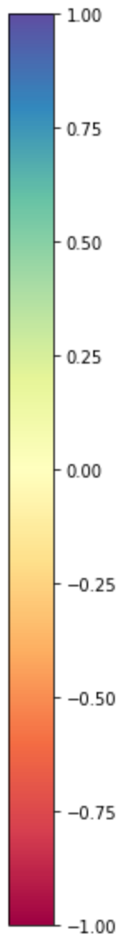
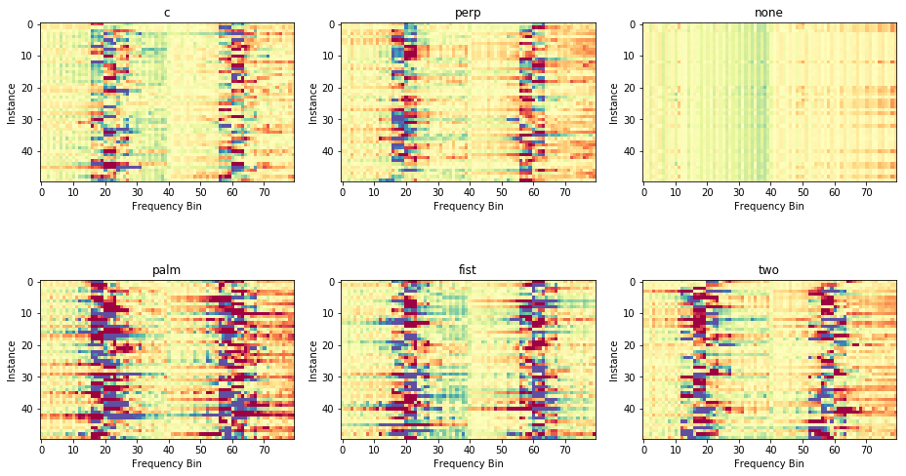
Data Visualization

Slide 47
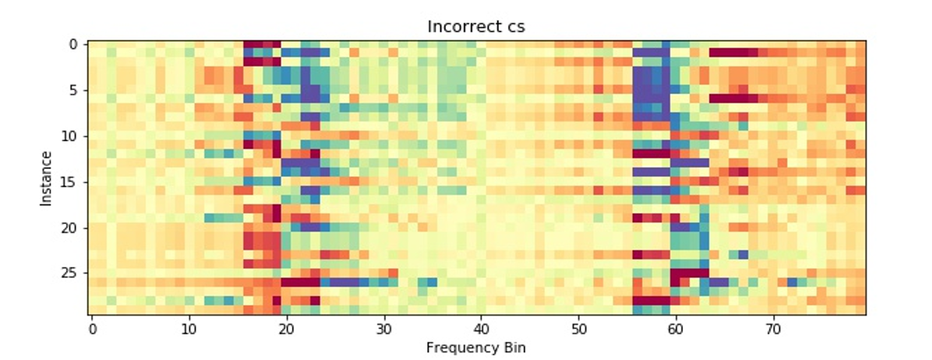
Misclassified Gestures
 | Predicted |  | Predicted
0 | perp | 15 | two
1 | palm | 16 | two
2 | perp | 17 | perp
3 | two | 18 | perp
4 | two | 19 | fist
5 | two | 20 | perp
6 | palm | 21 | perp
7 | perp | 22 | perp
8 | two | 23 | two
9 | perp | 24 | perp
10 | two | 25 | perp
11 | perp | 26 | two
12 | fist | 27 | perp
13 | perp | 28 | fist
14 | two | 29 | perp

Slide 48
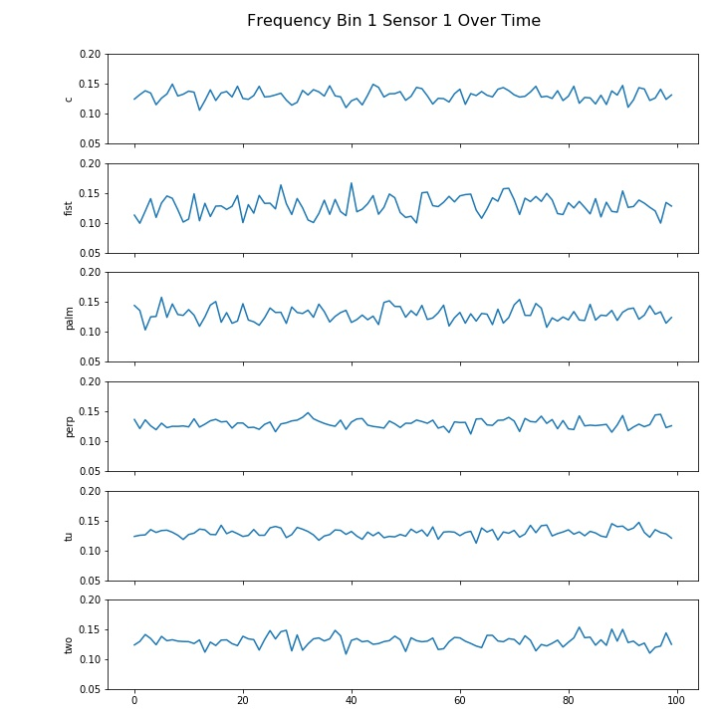
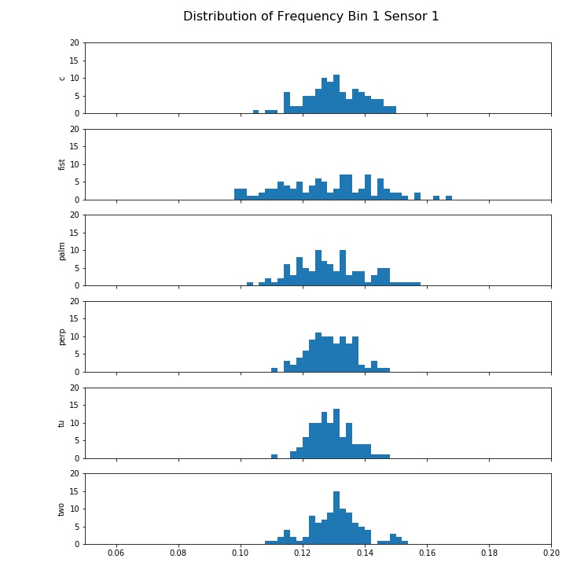
Data Visualization
Time Series Plot
Histogram Plot

